Slide 1
Scaling Up Visual and Vision-Language
Representation Learning With Noisy Text Supervision
ALIGN: A Large-scale ImaGe and Noisy-text embedding
(ICML 2021, by Google)
Hakjun Moon
02/02/2024

Slide 2
ALIGN
A Good Vision-Language Matching Model

Slide 3
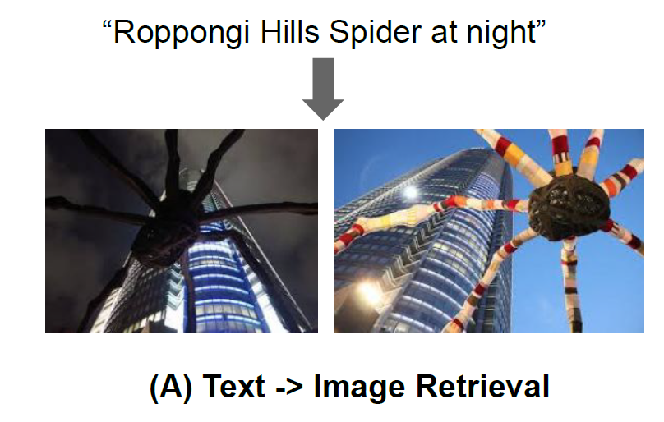
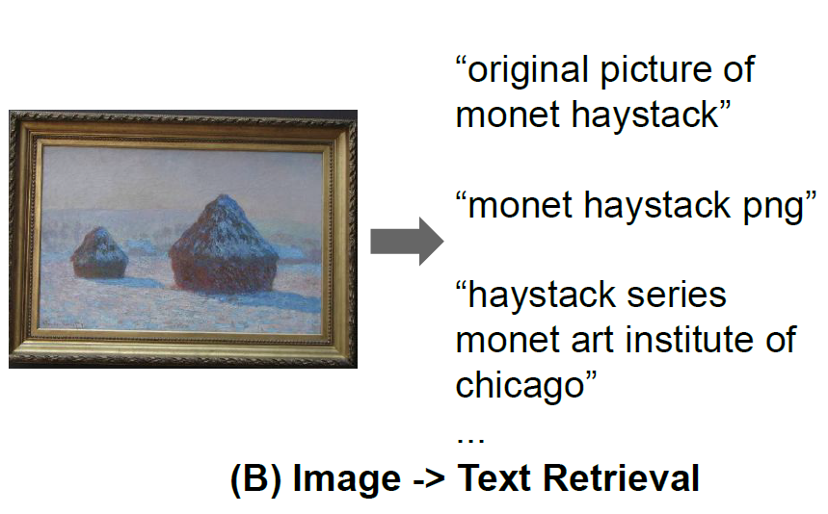
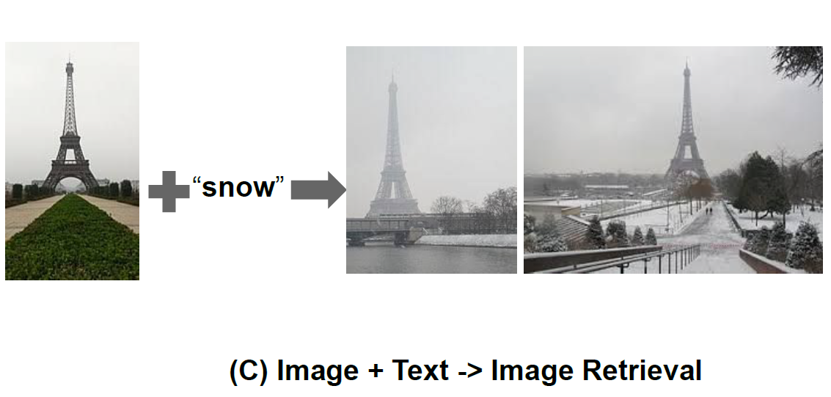
ALIGN Tasks

Slide 4
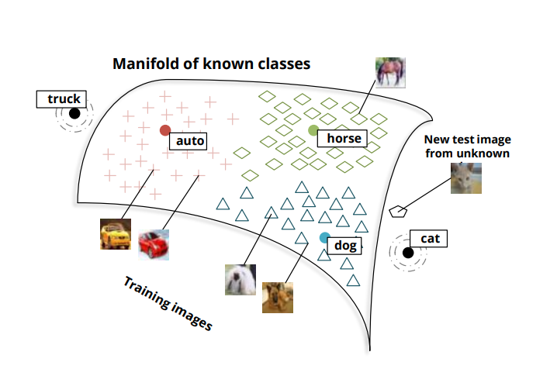
Zero-Shot Learning

Slide 5
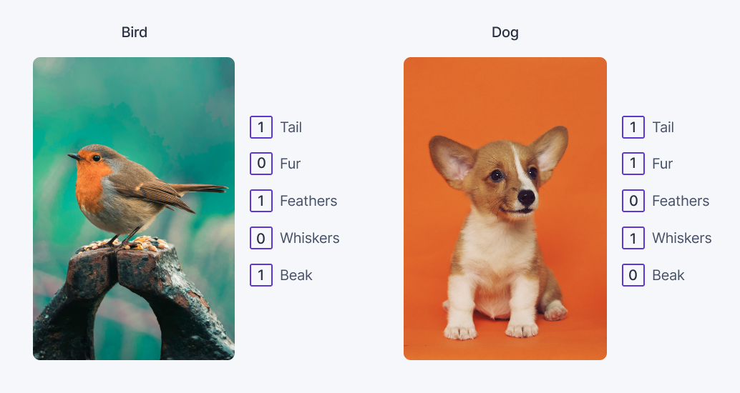
Zero-Shot Learning
Notes:
우선 Zero shot learning도 지도학습이다. 그러나 기존의 지도학습과는 다른 방법으로 예측하는데 바로 semantic information을 활용하는 것이다.
예를 들어 이러한 방식으로 각 이미지의 특징들을 embedding하는 것이다. 이러한 attributes는 Wikipedia or word corpus를 활용하는 방법들이 있다.
추가적으로 CNN이나 Transformer를 통해 이미지의 특징들을 추출해낼 수 있다.

Slide 6
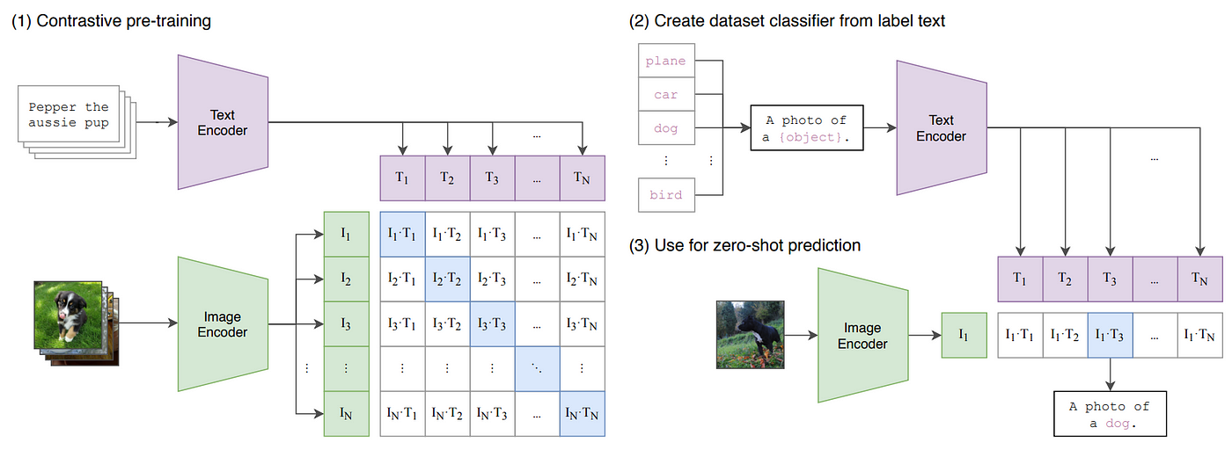
CLIP: ICML 2021 (by OPENAI)

Slide 7
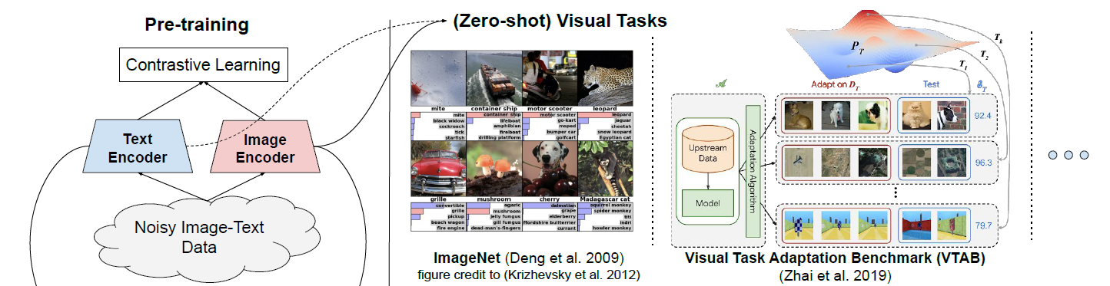
ALIGN: Pre-training
Image Encoder : EfficientNet
Text Encoder: BERT

Slide 8
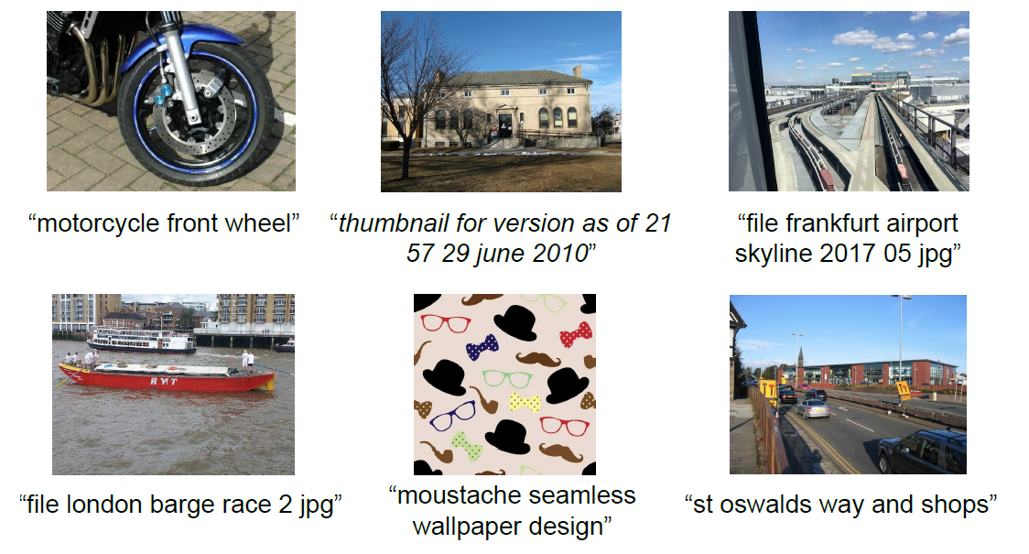
A Large-Scale Noisy Image-Text Dataset
# 1.8 billion image-text pairs (with noise)

Slide 9
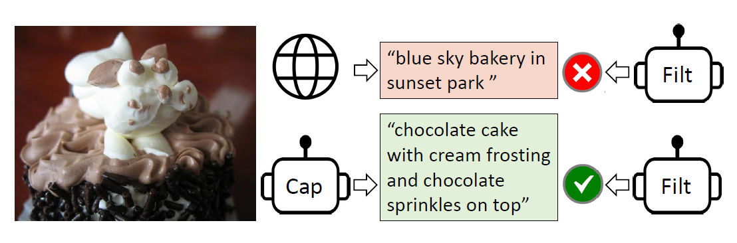
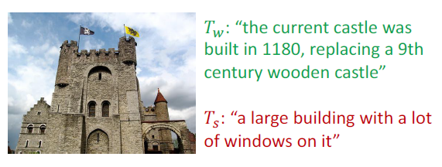
Dataset Labeling Comparison vs CLIP/BLIP
“A photo of a {label}.”
“A photo of a {label}, a type of pet.”
CLIP: Idea of Prompt Engineering
#Dataset : 400 million
BLIP: Idea of “CapFilt” (Caption and Filtering)
#Dataset : 14 million

Slide 10
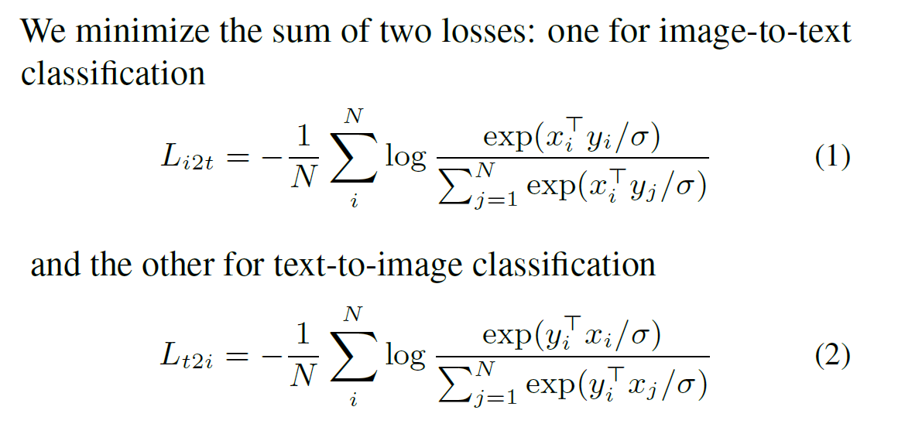
ALIGN Training: Contrastive Learning
Positive: matched image-text pairs
Negative : all other random image-text pairs that can be formed

Slide 11
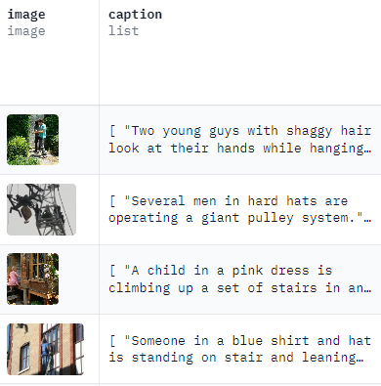
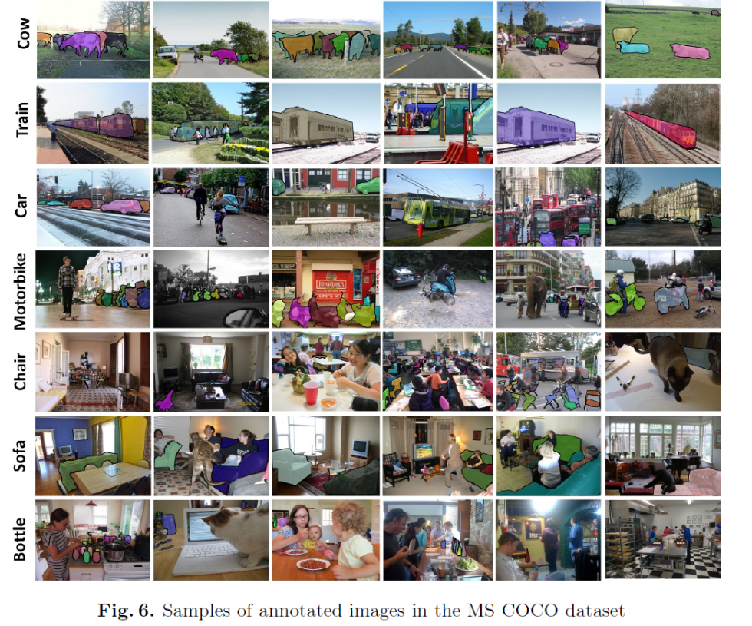
Image-text retrieval results on Flickr30K and MSCOCO datasets

Slide 12
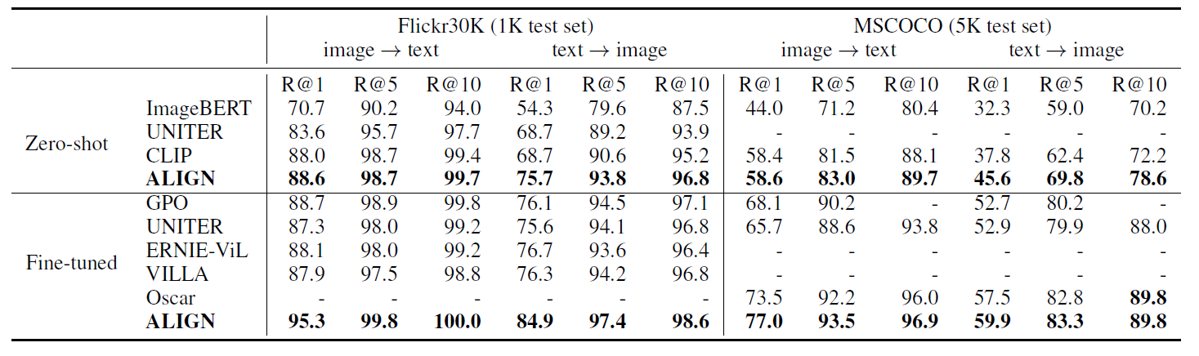
Image-text retrieval results on Flickr30K and MSCOCO datasets

Slide 13
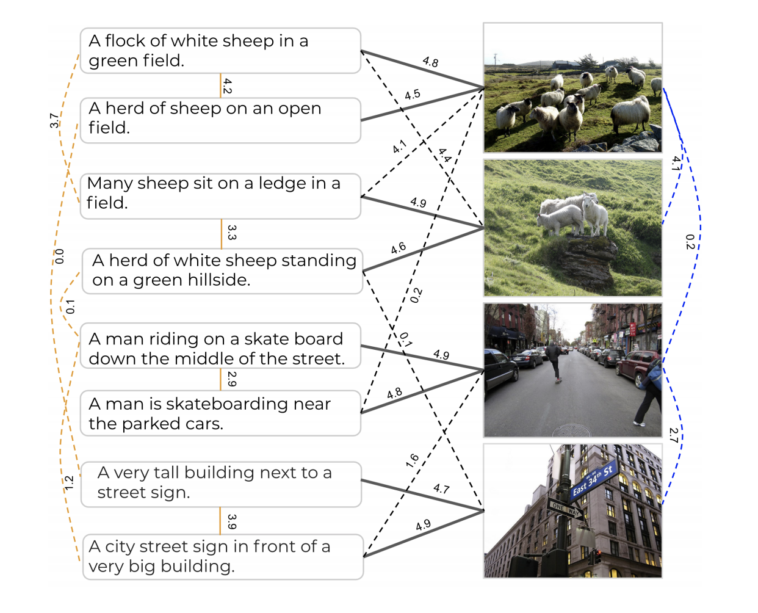
Multimodal retrieval performance on Crisscrossed Captions (CxC) dataset

Slide 14
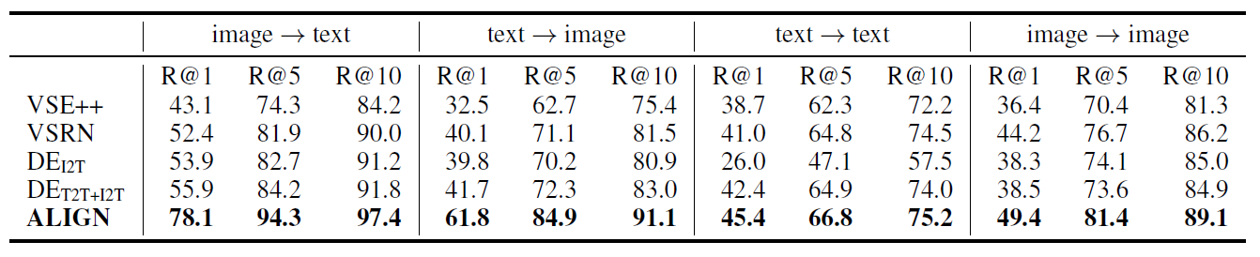
Multimodal retrieval performance on Crisscrossed Captions (CxC) dataset

Slide 15
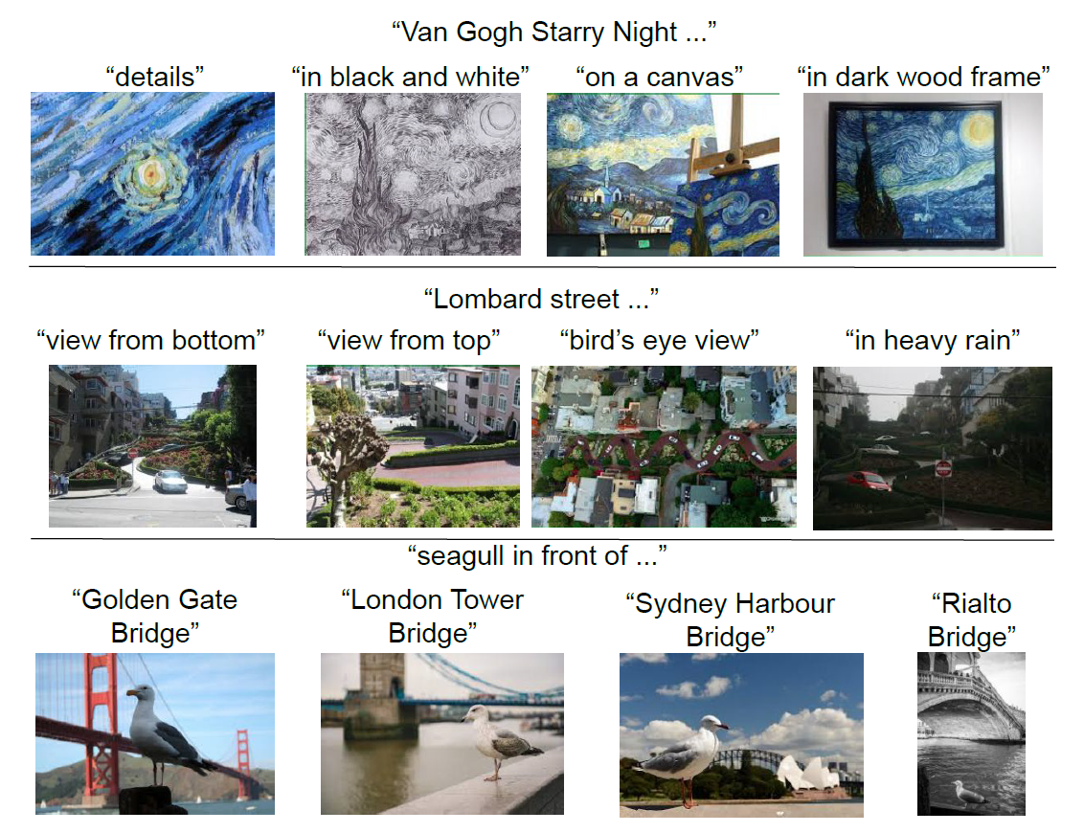
Image retrieval with fine-grained text queries using ALIGN’s embeddings

Slide 16
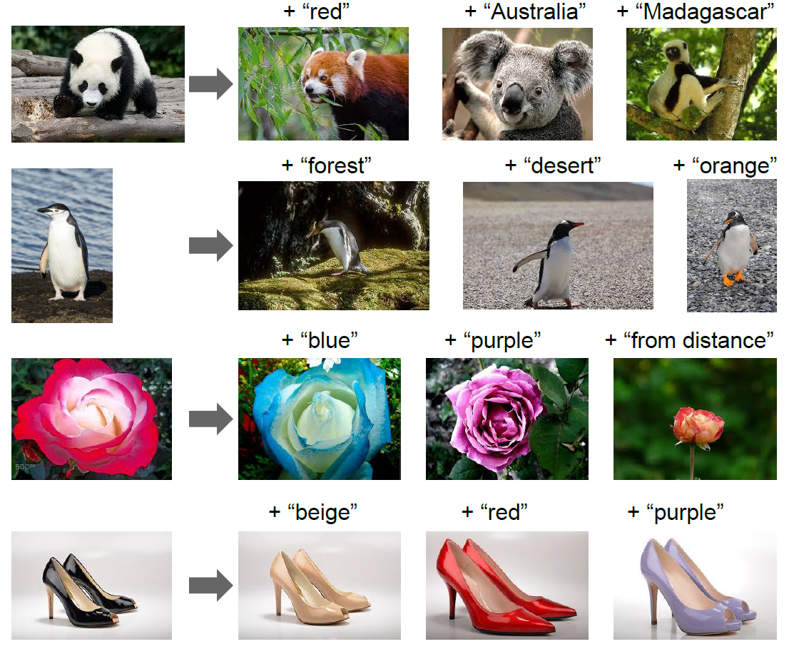
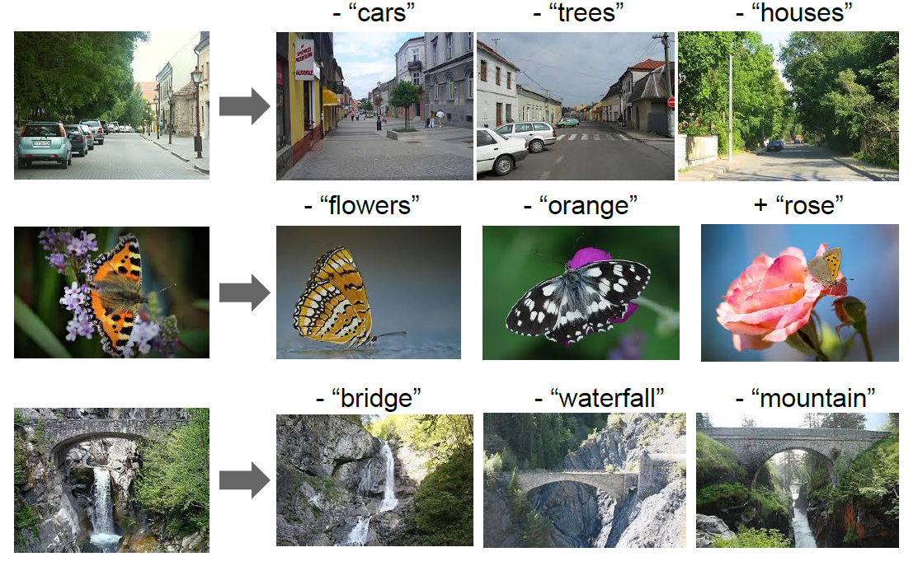
Image retrieval with image ± text queries

Slide 17
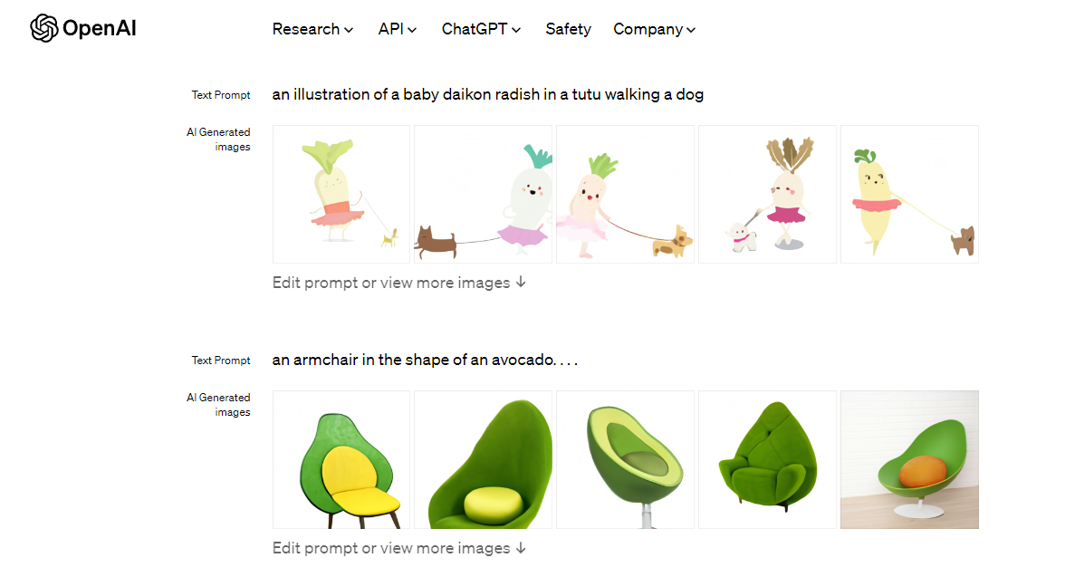
Related Papers: DALL-E

Slide 18
Questions
Question 1: What distinguishes vision-language representation learning from traditional vision tasks?
Question 2: How does the quality and nature of the dataset in ALIGN, with its minimal preprocessing and noisy data, impact the model's learning and performance compared to more curated datasets like the one used by BLIP?

